Slide 1
Learning Objectives
To understand the definitions on the ‘Trans Umbrella’
To identify the ‘Elements of Disco’
To create your own arrangement of ‘I will survive’ on logic Express or live classroom instruments.

Slide 3
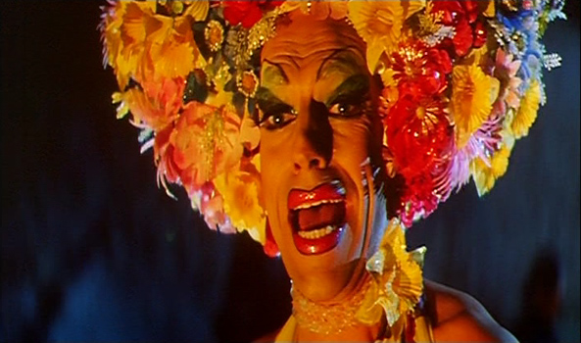
Listen and watch this clip of ‘I will survive’ from Priscilla Queen of the Desert
http://www.youtube.com/watch?v=0DJC-ECU8IE

Slide 4
Definitions – Please discuss in pairs note: remember to respect each others answers
What does ‘Trans’ mean?
How many words can you come up with that begin with ‘Trans’?
How does the word ‘Trans’ relate to gender?

Slide 5
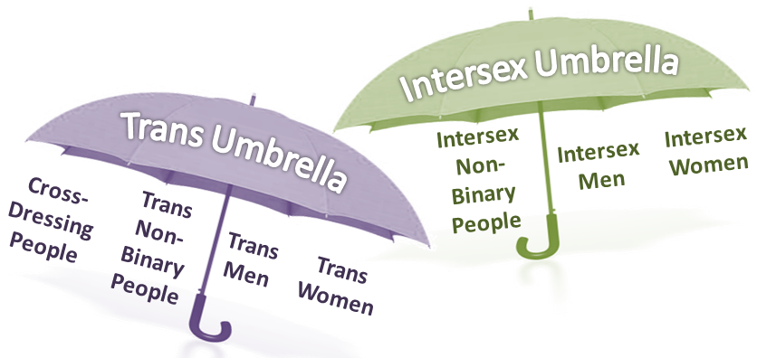
Trans is a prefix meaning to ‘cross over’. Trans men were identified at birth as female but now identify as male. Trans women were identified at birth as female but now identify as female. This may involve ‘gender re-assignment’ treatment including surgery. Cross-dressers sometimes or always wear the clothes of the opposite gender. Artist Grayson Perry and comedian Eddie Izzard are cross-dressers.
Inter is a prefix meaning ‘between’ or ‘among’. Intersex people have mental and/or physical features of both sexes and usually do not propose to change gender.
Non-binary is more of an attitude. Non-binary people reject the standard definitions of man and woman and recognise characteristics of both in themselves and in others.

Slide 6
Read through the lyrics and discuss
First I was afraid I was petrified kept thinking I could never live without you by my side
But I spent so many nights thinking how you did me wrong I grew strong I learned how to carry on
And so you're back from outer space I just walked in to find you here with that sad look upon your face
I should have changed my stupid lock I should have made you leave your key If I had known for just one second you'd be back to bother me
Go on now go walk out the door just turn around now 'cause you're not welcome anymore weren't you the one who tried to hurt me with goodbye you think I'd crumble you think I'd lay down and die
Oh no, not I, I will survive as long as I know how to love I know I will stay alive
I've got all my life to live, I've got all my love to give and I'll survive, I will survive.
It took all the strength I had not to fall apart kept trying hard to mend the pieces of my broken heart and I spent oh so many nights just feeling sorry for myself I used to cry now I hold my head up high and you see me somebody new, I'm not that chained up little person still in love with you
and so you felt like dropping in and just expect me to be free now I'm saving all my loving for someone who's loving me

Slide 7
Hand out worksheet 1
Listen to the song again and identify the following elements of disco:
Rhythm 120bpm – ‘4 on the floor’, bass drum on every beat, hi-hat on the off beat, snare on 2 and 4, cheesy handclaps.
Bassline - walking bassline in octaves
Syncopated chords – using 7ths and 9ths on a synthesizer sound
Riff – played by brass or strings
Vocals – sings the melody, usually with lyrics about dancing.

Slide 8
25 minutes composition time
Using worksheet 2 as a reference construct a rhythm track, bassline, chord sequence and riff either on your own using logic express or using live instruments in a group.

Slide 9
Celebrate your learning
Video your group performance using the flip camera
Play back on the IWB
Play back your arrangement from logic express
Verbally assess your achievements:
- How many of the elements of disco have you included?
- What were the difficulties you had to overcome?
- Is the arrangement successful?
- How can you improve your arrangement?

